Slide 1
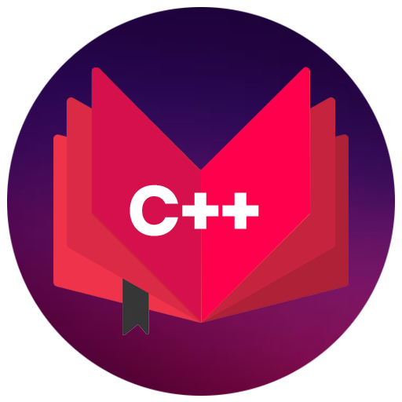
OBJECT ORIENTED PROGRAMMING USING C++

Slide 2
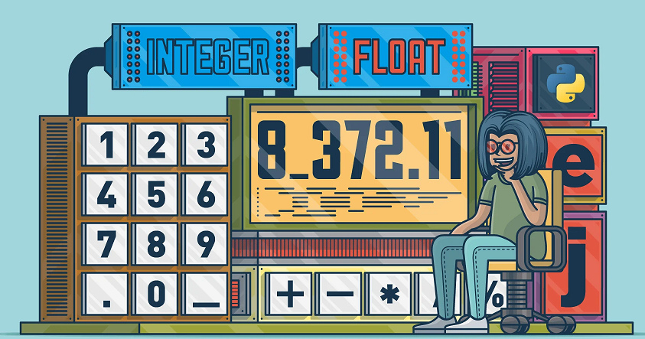

Basic concepts of object oriented programming

Slide 3
Programming Structure of C++
1. Document section
2. Pre-processor Statement with header File
3. Predefined Standard Namespace
4. Global Declaration
5. Class statement
6. Main Function

Slide 4
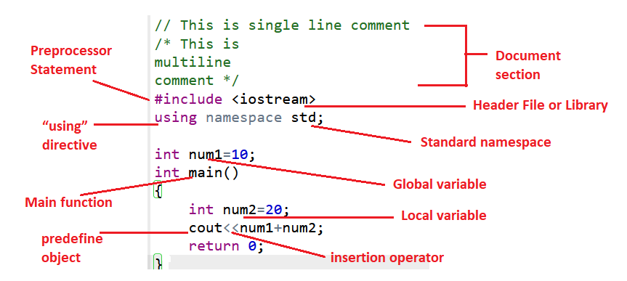

Slide 5
using namespace std;
It is known that “std” (abbreviation for the standard) is a namespace whose members are used in the program.
So the members of the “std” namespace are cout, cin, endl, etc.
This namespace is present in the iostream.h header file.
The using directive means to include the whole code written in the namespace in the closing scope.

Slide 6
Need of namespace:
As the same name can’t be given to multiple variables, functions, classes, etc. in the same scope.
So to overcome this situation namespace is introduced.

Slide 7
Data types
User-define type
Built-in-type
Derived type
Integer
Character
Boolean
Floating Point
Double
Class
Structure
Union
Function
Array
Pointer

Slide 8
Primitive Data Types: These data types are built-in or predefined data types and used to declare variables.
Primitive data types available in C++ are:
Integer(int)
Character(char)
Boolean(bool)
Floating Point(float)
Double Floating Point(double)

Slide 9
Derived Data Types: The data-types that are derived from the primitive or built-in datatypes are referred to as Derived Data Types.
These are:
Function
Array
Pointer

Slide 10
Abstract or User-Defined Data Types: These data types are defined by user itself.
class
structure
union
enumeration or enum

Slide 11
Data type | Size(in byte) | Range
char | 1 =8 bits ( 2⁸ ) | -128 to 127 or 0 to 255
unsigned char | 1 | 0 to 255
signed char | 1 | -128 to 127
int | 4=32 bits ( 2³² ) | -2,147,483,648 to 2,147,483,647
short int | 2 | -32,768 to 32,767
unsigned short int | 2 | 0 to 65,535
unsigned int | 4 | 0 to 4,294,967,295
float | 4
double | 8
long double | 12
We can display the size of all the data types by using the sizeof() operator

Slide 12
Memory representation
1 Byte= 8 Bits
128 0 | 64 1 | 32 0 | 16 0 | 8 0 | 4 0 | 2 0 | 1 1
A(65)=01000001
char ch=65;
Or
char ch=‘A’
Char is occupying 1 Byte memory

Slide 13
How to find out range?
For Signed data types:
1.) calculate total number of bits
2.) Calculate -2^(n-1) for minimum range
3.) Calculate (2^(n-1))-1 for maximum range
Unsigned Data Types:
1.)Find number of bits
2.)minimum range is always zero for unsigned data type
3.)for maximum range calculate 2^n-1

Slide 14
Example:
Char : 1 byte: 8 bits=n
Signed: -2⁽⁸⁻¹⁾ to (2⁽⁸⁻¹⁾)-1
=-128 to 127
Unsigned:
0 to 2⁽⁸⁾-1
^{=0 to 255}

Slide 15
What will be output?
#include <iostream>
using namespace std;
int main()
{
int num=2147483648;
cout <<num<< endl;
return 0;
}
2147483648
- 2147483648
Error
None

Slide 16
Data type modifiers are:
Signed
Unsigned
Short
Long

Slide 17

Today we are going to learn about……?

Slide 18
Operators
Arithmetic operators
Assignment operators
Comparison operators
Logical operators
Bitwise operators
Increment /decrement operators
insertion operator/ extraction operator

Slide 19
Arithmetic operators
Operator | Name | Example
+ | Addition | x + y
- | Subtraction | x - y
* | Multiplication | x * y
/ | Division | x / y
% | Modulus | x % y

Slide 20
Assignment Operators
Operator | Example | Same As
= | x = 5 | x = 5
+= | x += 3 | x = x + 3
-= | x -= 3 | x = x - 3
*= | x *= 3 | x = x * 3
/= | x /= 3 | x = x / 3
%= | x %= 3 | x = x % 3
&= | x &= 3 | x = x & 3
|= | x |= 3 | x = x | 3
^= | x ^= 3 | x = x ^ 3
>>= | x >>= 3 | x = x >> 3
<<= | x <<= 3 | x = x << 3

Slide 21
Comparison operators
Operator | Name | Example
== | Equal to | x == y
!= | Not equal | x != y
> | Greater than | x > y
< | Less than | x < y
>= | Greater than or equal to | x >= y
<= | Less than or equal to | x <= y

Slide 22
Logical operators
Operator | Name | Description | Example
&& | Logical and | Returns true if both statements are true | x < 5 && x < 10
|| | Logical or | Returns true if one of the statements is true | x < 5 || x < 4
! | Logical not | Reverse the result, returns false if the result is true | !(x < 5 && x < 10)

Slide 23
Problem statement
Write a program to display the student's result in terms of grade from the following condition:
If marks between 90 to 100:grade'O'
marks between 80 to 90:grade'A+'
marks between 70 to 80:grade'A'
marks between 60 to 70:grade'B+'
marks between 50 to 60:grade'B'

Slide 24
Bitwise operators
Operator | Description
& | AND Operator
| | OR Operator
^ | XOR Operator
~ | Ones Complement Operator
<< | Left Shift Operator
>> | Right Shift Operator

Slide 25
AND Operator (&)
If both side bit is on result will be On
a | b | a & b
0 | 0 | 0
0 | 1 | 0
1 | 0 | 0
1 | 1 | 1

Slide 26
Steps to solve:-
a = 12 (find binary form:1100 )
b = 25 (find binary form:11001)
How to find Binary:
64 32 16 8 4 2 1
0 1 1 0 0
12
25
8
1 1 0 0 1
1 0 0 0

Slide 27
a & b=
01100 (12)
11001 (25)
01000 (8) Ans.

Slide 28
What will be output?
#include <iostream>
using namespace std;
int main()
{
int a=20;
int b=25;
cout<<(a&b);
return 0;
}
15
16
20

Slide 29
OR Operator (|)
If any side bit is on result will be On
a | b | a | b
0 | 0 | 0
0 | 1 | 1
1 | 0 | 1
1 | 1 | 1

Slide 30
Steps to solve:-
a = 12 (find binary form:1100 )
b = 25 (find binary form:11001)
How to find Binary:
64 32 16 8 4 2 1
0 1 1 0 0
12
25
29
1 1 0 0 1
1 1 1 0 1

Slide 31
a | b=
01100 (12)
11001 (25)
11101 (29) Ans.

Slide 32
What will be output?
#include <iostream>
using namespace std;
int main()
{
int a=20;
int b=15;
cout<<(a|b);
return 0;
}
31
32
22
32

Slide 33
XOR Operator (^)
If both side bit is opposite result will be On
a | b | a ^ b
0 | 0 | 0
0 | 1 | 1
1 | 0 | 1
1 | 1 | 0

Slide 34
Steps to solve:-
a = 12 (find binary form:1100 )
b = 25 (find binary form:11001)
How to find Binary:
64 32 16 8 4 2 1
0 1 1 0 0
12
25
21
1 1 0 0 1
1 0 1 0 1

Slide 35
a ^ b=
01100 (12)
11001 (25)
10101 (21) Ans.

Slide 36
Left Shift Operator(<<)
a=10 (1010)
a<<1
1010.0
10100(20) Ans.
a<<2
1010.00
101000(40) Ans.

Slide 37
Right Shift Operator(>>)
a=10 (1010)
a>>1
1010.
101(5) Ans.
a>>2
1010.
10(2) Ans.

Slide 38
What will be output?
#include <iostream>
using namespace std;
int main()
{
int a=15;
cout<<(a>>1);
return 0;
}
Options:
5
6
7
8

Slide 39
Increment/Decrement Operator
++: Increment: pre/post
++x
Pre-increment first then assign
++a
//a=a+1
//a=a
Post-assign first then increment
a++
//a=a
//a=a+1
--: Decrement: pre/post
--x
int main()
{
int a=10;
a++;
cout<<a;
return 0;
}

Slide 40
What will be output?
#include <iostream>
using namespace std;
int main()
{
int a=10;
cout<<a++;
return 0;
}
#include <iostream>
using namespace std;
int main()
{
int a=10;
cout<<++a;
return 0;
}

Slide 41
What will be output?
#include<iostream>
using namespace std;
int main()
{
int x = 5, y = 5, z;
x = ++x; y = --y;
z = x++ + y--;
cout << z;
return 0;
}

Slide 42
insertion operator(<<):
The cout is used in conjunction with stream insertion operator (<<) to display the output on a console
extraction operator (>>):
The cin is used in conjunction with stream extraction operator (>>) to read the input from a console.

Slide 43
Control structure
Conditional structure: if and else
Selective structure: switch case
Iteration structures (loops): while, do while, for
Jump statements: break, continue, goto

Slide 44
if and else
if(condition)
{
//Statements(execute when condition true)
}
else
{
//Statements(execute when condition false)
}

Slide 45
Switch …case
For menu options:
switch(choice)
{
case 1:
break;
default:
}

Slide 46
What will be output?
#include <iostream>
using namespace std;
int main()
{
int a=10;
switch(a)
{
case 11:
cout<<“Hi";
case 10:
cout<<“Hello";
case 12:
cout<<“Bye”;
}
return 0;
}
Hi
Hello
HiHello
None

Slide 47
#include <iostream>
using namespace std;
int main()
{
int choice=7;
switch(choice)
{
case 3:
cout<<"3";
break;
case 1:
cout<<"1";
break;
default:
cout<<"d";
case 2:
cout<<"2";
}
return 0;
}
d
d2
Error
None

Slide 48
While loop
The syntax of a while loop in C++ is −
while(condition)
{
statement(s);
}
#include <iostream>
using namespace std;
int main ()
{
int a = 10;
while( a < 20 )
{
cout<< a << endl;
a++;
}
return 0;
}

Slide 49
Do While loop: at least one time will be execute
The syntax of a do while loop in C++ is −
do {
statement(s);
}
while( condition );
#include <iostream>
using namespace std;
int main ()
{
int a = 10;
do
{
cout<< a << endl;
a++;
} while( a > 20 );
return 0;
}

Slide 50
For loop:
The syntax of a for loop in C++ is −
for ( initialization; condition; increment )
{
statement(s);
}

Slide 51
Jump statements: break, continue, goto
break: It breaks the current flow of the program at the given condition.
continue: It continues the current flow of the program and skips the remaining code at specified condition.
goto: It is used to transfer control to the other part of the program. It unconditionally jumps to the specified label.

Slide 52
What will be output?
#include <iostream>
using namespace std;
int main()
{
for(int i=1;i<=5;i++)
{
if(i==3)
break;
cout<<i;
}
return 0;
}
12345
123
1245
None

Slide 53
go to Jumping Statement
#include <iostream>
using namespace std;
int main()
{
ineligible:
cout<<"You are not eligible to vote!\n";
cout<<"Enter your age:\n";
int age;
cin>>age;
if (age < 18){
goto ineligible;
}
else
{
cout<<"You are eligible to vote!";
}
}

Slide 54
What will be output?
#include <iostream>
using namespace std;
void print(int i)
{
cout << i;
}
void print(double f)
{
cout << f;
}
int main()
{
print(5);
print(500.263);
return 0;
}
A) 5500.263
B) 500.2635
C) 500.263

Slide 55
Any Query?

